Slide 1
APA Formatting and Style Guide
Purdue OWL staff
Brought to you in cooperation with the Purdue Online Writing Lab
Notes:
Welcome to “APA Formatting and Style Guide.” This Power Point Presentation is designed to introduce your students to the basics of APA formatting and style. You might want to supplement the presentation with more detailed information posted on the Purdue OWL https://owl.purdue.edu/owl/research_and_citation/apa_style/apa_formatting_and_style_guide/index.html

Slide 2

What is APA Style?
The American Psychological Association (APA) citation style is the most commonly format for manuscripts in the social sciences:
  APA regulates
  Stylistics
  In-text citations
  References
Notes:
Publication Manual of the American Psychological Association, 7th ed., contains detailed guidelines for formatting a paper in APA style. APA style is most commonly used for formatting papers in the social sciences—business, economics, psychology, sociology, nursing, etc. Updates to APA are posted on the APA website www.apastyle.org.
APA format provides writers with a format for cross-referencing their sources—from their parenthetical references to their reference page. This cross-referencing system allows readers to locate the publication information of source material. This is of great value for researchers who may want to locate your sources for their own research projects. The proper use of APA style also shows the credibility of writers; such writers show accountability to their source material. Most importantly, use of APA style can protect writers from plagiarism—the purposeful or accidental use of source material by other writers without giving appropriate credit.

Slide 3
Point of View
Use first-person point of view rather than third-person:
    ✓: “We conducted an experiment…”
    ✗: “The authors conducted an experiment….”
Notes:
This slide introduces the basics of APA stylistics related to the point of view in an APA paper, which encourages a writer to use personal pronouns. The explanation is provided with examples.

Slide 4
Voice
Use active voice when stressing the actions of the research:
    ✓: “We asked participants questions.”
    ✗: “The participants have been asked questions by the researchers.”
Use passive voice when stressing the recipient or object of the action:
    ✓: “The tests were inconclusive.”
    ✗: “We found the tests inconclusive.”
Notes:
This slide introduces the basics of APA stylistics related to the point of view in an APA paper, which encourages a writer to use personal pronouns. The explanation is provided with examples.

Slide 5
Language
Language in an APA paper should be:
Clear: Be specific in descriptions and explanations.
Concise: Condense information when you can.
Plain: Use simple, descriptive adjectives and minimize figurative language.
Notes:
This slide explains the language qualities the APA recommends for academic papers.
Clarity and conciseness are the major concerns when reporting research in APA. It is not easy to balance clarity (which requires accuracy) and conciseness (which requires packing information). To achieve clarity, a writer should avoid vague wording and be specific in descriptions and explanations. To achieve conciseness, a writer should condense information. Because APA format is widely used in science-related papers, the language of APA format is plain and simple. A writer should avoid using metaphors and minimize the use of figurative language, which is typical for creative writing.
This slide can be supplemented by the “Concision” handout from the OWL: https://owl.purdue.edu/owl/general_writing/academic_writing/conciseness/index.html

Slide 6
Quantitative Articles
Report quantitative research, which uses empirical and numerical information often analyzed through statistical means.
Quantitative articles include:
  Title Page
  Abstract
  Introduction
  Method
  Results
  Discussion
Notes:
This slide introduces one of the most common APA-style papers: the quantitative article.
Quantitative articles report quantitative research, which uses empirical and numerical information often analyzed through statistical means. Refer to the slides on tables and figures for more information on formatting statistics.

Slide 7
Qualitative Articles
Report qualitative research, which uses scientific practices to learn more about human experiences that cannot be numerically quantified.
Qualitative articles include:
  Title Page
  Abstract
  Introduction
  Method
  Findings/Results
  Discussion
Notes:
This slide introduces another common APA-style papers: the qualitative article.
Qualitative articles report qualitative research, which uses scientific practices to learn more about human experiences that cannot be numerically quantified.

Slide 8
The Literature Review
Summarizes scientific literature on a particular research topic.
While the APA Publication Manual does not require a specific order for a literature review, a good literature review typically contains the following components:
  Introduction
  Thesis Statement
  Summary and Synthesis of Sources
  List of References
Notes:
This slide introduces a third common APA-style papers: the literature review.
A literature review paper, which is the summary of what the scientific literature in the discipline field says about the topic of research, is the genre students likely encounter in their academic studies. The paper includes the introduction, thesis statement, summary and synthesis of sources, and a reference list.

Slide 9
Types of APA Papers
If your essay is not quantitative, qualitative, or a literature review:
  Consult the instructor
  Consult the APA Publication Manual
Notes:
The general format, which is introduced in the following six slides, regulates formatting papers of any genre students may encounter in their academic studies. For students, consulting the instructor about the specific requirement is the safest policy. For authors of manuscripts prepared for submission to a scientific journal, consulting Publication Manual is a must.

Slide 10
General APA Format
Your essay should be:
  Typed
  Double-spaced
  Have 1” margins
  Use 10-12pt. standard font (ex. Times New Roman)
  Printed on standard-sized paper (8.5” x 11”)
Notes:
The general format, which is introduced in the following six slides, regulates formatting papers of any genre students may encounter in their academic studies. For students, consulting the instructor about the specific requirement is the safest policy. For authors of manuscripts prepared for submission to a scientific journal, consulting Publication Manual is a must.

Slide 11
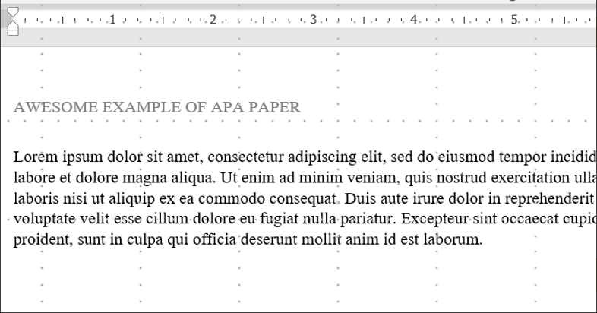
General APA Format
Every page of your essay should include:
The page number in the upper right
  If the text is a professional paper, a page header (shortened title in all caps) should appear in the upper left-hand corner.
  If the text is a student paper, a running head is not required.
Notes:
The general format, which is introduced in the following six slides, regulates formatting papers of any genre students may encounter in their academic studies. For students, consulting the instructor about the specific requirement is the safest policy. For authors of manuscripts prepared for submission to a scientific journal, consulting Publication Manual is a must.

Slide 12
General APA Format
References
Your essay should include four major sections:
Main Body
Abstract
Title page
Notes:
This slide introduces four required part of an APA paper: a title page, abstract, main body (essay itself), and a reference list. An abstract page and list of references are titled as Abstract and References, respectively.
It is important to remind students that each page should have a page header with a shortened version of the title and page number.
This slide can be supplemented by the “General Format” section from the OWL https://owl.purdue.edu/owl/research_and_citation/apa_style/apa_formatting_and_style_guide/general_format.html

Slide 13
Types of APA Papers
Note that APA 7 has slightly different formatting rules for professional and student papers. Professional papers are those intended for academic/commercial publication, while student papers are those written for credit in a course.
Most of these differences extend to the title page and the running header.
  On the next few slides, we’ve noted these differences where appropriate.
Notes:
This slide informs readers that APA 7 distinguishes between professional and student papers in terms of paper formatting. It notes that most of the differences extend only to the title page and the running header and explains that these differences will be illustrated in the following few slides.

Slide 14
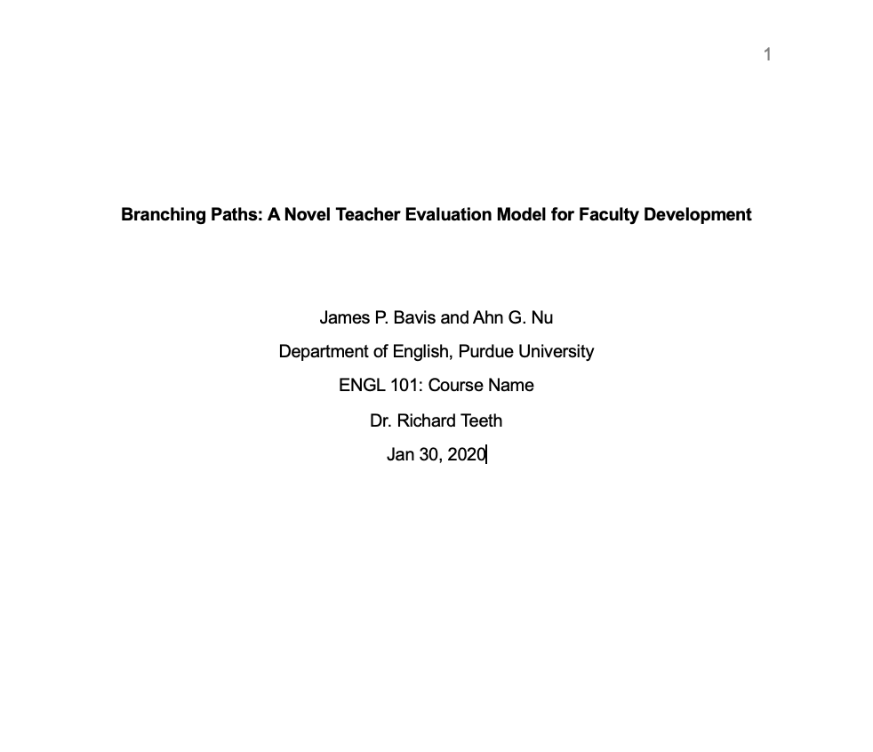
Title Page: Student Paper
Page header: Student papers contain no running head. Simply insert a page number flush right.
Title (in the upper half of the page, centered)
Name (no title or degree), academic department, course, instructor, and date
Notes:
This slide provides a visual example for the proper placement of the page header and the full title on the cover page of a student paper.
Student papers require no headers other than a page number (flush right).
Type the complete title in the upper half of the page bolded and centered. Below the title, type your name and your affiliation (university, etc.)
This slide can be supplemented by the “General Format” page from the OWL:
https://owl.purdue.edu/owl/research_and_citation/apa_style/apa_formatting_and_style_guide/general_format.html

Slide 15
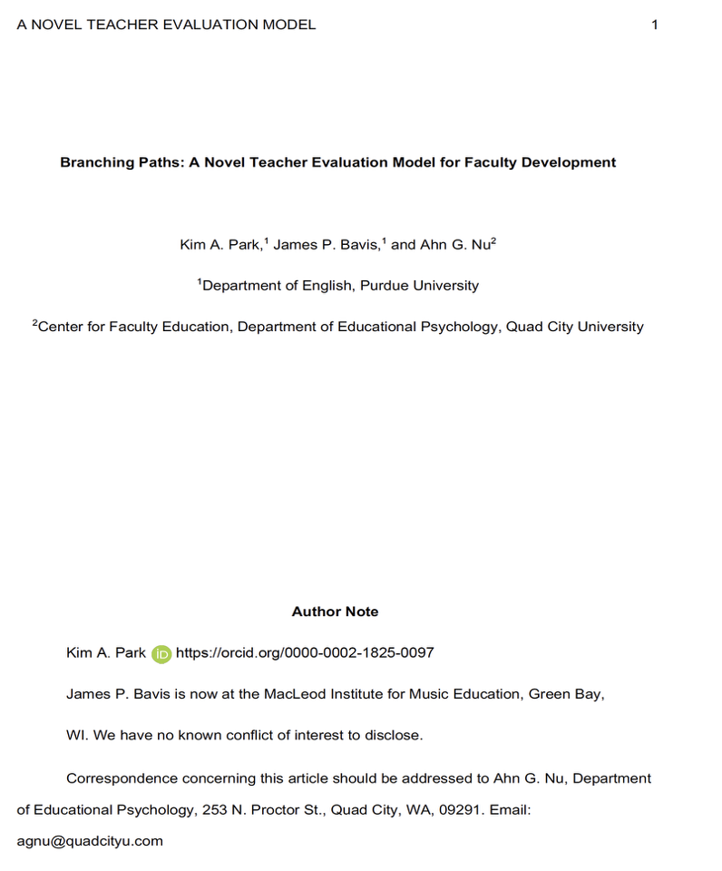
Title Page: Professional Paper
Page header: Insert header. Type short form of title. Flush left in all capitals and add page number flush right.
Title (in the upper half of the page, centered), followed by name (no title or degree) and affiliation (university, etc.)
Notes:
This slide provides a visual example for the proper placement of the page header and the full title on the cover page of a professional paper. Type a shortened form of the paper’s title in all capitals in the page header flush left with the page number flush right.
Type the complete title in the upper half of the page bolded and centered. Below the title, type your name and your affiliation (university, etc.)
This slide can be supplemented by the “General Format” page from the OWL: https://owl.purdue.edu/owl/research_and_citation/apa_style/apa_formatting_and_style_guide/general_format.html

Slide 16
Title Page: Professional Paper
Author Note may contain links to
ORCID iDs, any affiliation changes, special disclosures or acknowledgments, and/or contact info for the corresponding authors. Each item should be on a separate line.
Omit any items that are irrelevant.
Notes:
This slide provides a visual example for the proper placement of the author note on the cover page of a professional paper. Label the note with the words “Author Note,” bolded and centered. Following this, you may provide any or all of the following:
Links to ORCID iDs
Affiliation changes
Any special disclosures or acknowledgments
Contact info for the corresponding author
Omit any items that are irrelevant.
This slide can be supplemented by the “General Format” page from the OWL:
https://owl.purdue.edu/owl/research_and_citation/apa_style/apa_formatting_and_style_guide/general_format.html

Slide 17
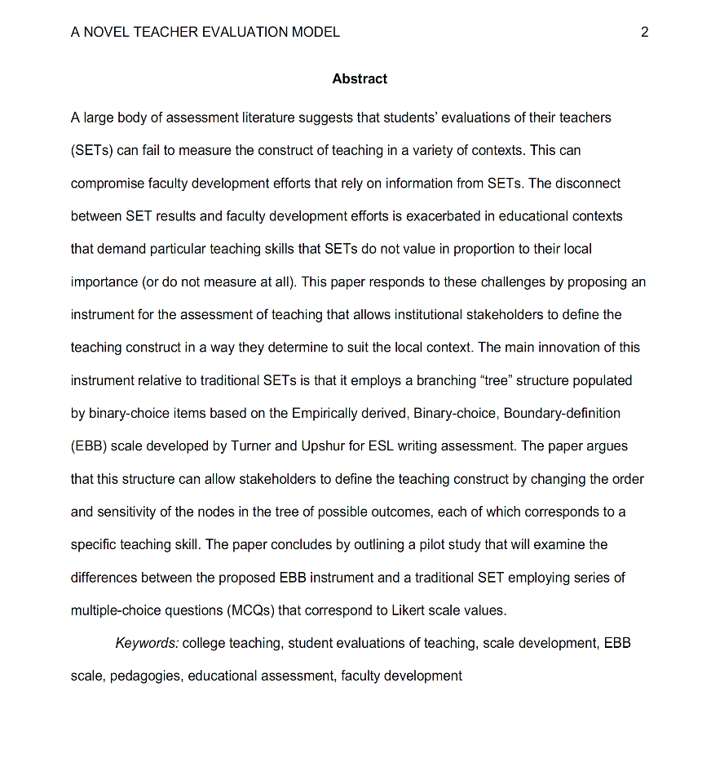
Abstract Page
For abstracts, write a 150- to 250- word summary of your paper in an accurate, and concise manner.
Page header continues on all the subsequent pages for professional papers only.
Student papers contain only the page number.
For abstracts:
  The title needs to be centered and bolded at the top of the page.
  Follow the abstract with a short list of keywords.
Notes:
This slide provides a visual example of an abstract page, which consists of a page header, a heading (labeled Abstract), and a brief summary of the paper accurately presenting its contents.
Professional papers should contain a running head in the header (flush left) and a page number (flush right). Student papers should contain only the page number.
Type the heading –Abstract– centered at the top of the page. Below, type the paragraph of the paper summary (between 150 and 250 words) in block format—without indentation.
The abstract should contain the research topic, research questions, participants, methods, results, data analysis, and conclusions. It may also include possible implications of your research and future work you see connected with your findings.
A short list of keywords (labeled with “Keywords” in italics, written in line with the text) should follow the abstract. These are terms and concepts that might help readers find your work via a search engine.

Slide 18
Main Body (Text)
Number the first text page as page number 3.
Center and bold the (full) title of the paper at the top of the page.
Type the text double-spaced with all sections following each other without a break.
Identify the sources you use in the paper with either narrative citations or parenthetical, in-text citations
Format tables and figures.
Notes:
This slide provides the basic reminders about formatting the text:
Make sure that the first text page is page number 3 (page #1 is a title page, page #2 is an abstract page).
Start with typing the essay title centered and bolded at the top of the page.
Type the text double-space with all sections following each other without a break. Do not use blank space between paragraphs.
Create in-text citations to identify the sources used in the paper.
Format tables and figures.
The following slides introduce APA formatting of references, in-text citations, and tables and figures.

Slide 19
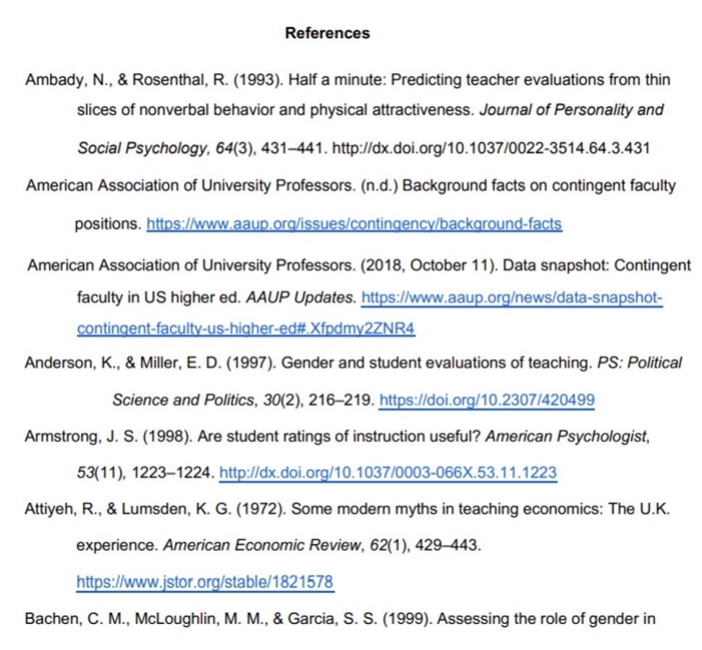
Reference Page
For abstracts, write a 150- to 250- word summary of your paper in an accurate, and concise manner.
Page header continues on all the subsequent pages for professional papers only.
Student papers contain only the page number.
For abstracts:
  The title needs to be centered and bolded at the top of the page.
  Follow the abstract with a short list of keywords.
Notes:
This slide explains the format and purpose of a references page.
The facilitator may stress that each source referenced within the paper should also appear on the reference page, which appears at the end of the paper.
To create a references page,
center and bold the heading—References—at the top of the page;
double-space reference entries;
flush left the first line of the entry and indent subsequent lines. To use “hanging” feature of “Indent and Space” tab, go to “Paragraph” →”Indentation” →choose “Hanging” in the ”Special” box.
Order entries alphabetically by the author’s surnames. If a source is anonymous, use its title as an author’s surname.
Note: Unlike MLA, APA is only interested in what they call “recoverable data”—that is, data which other people can find. For example, personal communications such as letters, memos, emails, interviews, and telephone conversations should not be included in the reference list since they are not recoverable by other researchers.
For specific information about entries in the reference list, go to https://apastyle.apa.org/style-grammar-guidelines/paper-format/sample-papers

Slide 20
Main Body (Text)
Invert authors’ names (last name first, followed by initials).
  Example: “Smith, J. Q.”
Capitalize only the first letter of the first word of a title and subtitle, the first word after a colon or a dash in the title, and proper nouns. Do not capitalize the first letter of the second word in a hyphenated compound word.
  Example: The perfectly formatted paper: How the Purdue OWL saved my essay.
Notes:
This slide provides basic rules related to creating references entries.

Slide 21
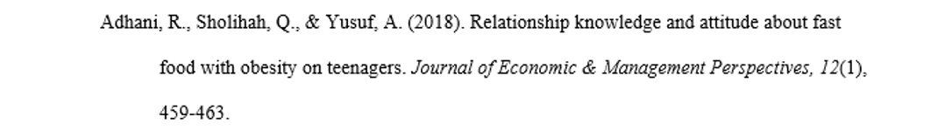
Reference: Basics
Capitalize all major words in journal titles.
Italicize titles of longer works such as books and journals.
Do not italicize, underline, or put quotes around the titles of shorter works such as journal articles or essays in edited collections.
Notes:
This slide provides basic rules related to creating references entries.

Slide 22
Making the Reference List
APA is a complex system of citation. When compiling the reference list, the strategy below might be useful:
1. Identify the type of source: Is it a book? A journal article? A webpage?
2. Find a sample citation for this type of source:
  Check a textbook or the OWL APA Guide: https://owl.purdue.edu/owl/research_and_citation/apa7_style/apa_formatting_and_style_guide/general_format.html
3. “Mirror” the sample.
4. Make sure that the entries are listed in alphabetical order and that the subsequent lines are indented (Recall References: Basics).
Notes:
APA is a complex system of citation that can be time-consuming to learn and difficult to recall when needed. To help students handle the requirements of APA format, this slide introduces a strategy of surviving APA.
The facilitator should stress the importance of correct identification of a type of source: e.g., Is it an article from a newspaper or from a scholarly journal? Hard copy or electronic version?
When the source type is identified correctly, it’s fairly easy to find a sample of a similar reference in the APA chapter of a composition book or in an online APA resource. The APA guide on the OWL website is particularly easy to browse since its links are organized by types of sources—scroll down to the box of links https://owl.purdue.edu/owl/research_and_citation/apa7_style/apa_formatting_and_style_guide/general_format.html
After a sample is found, all it takes is to mirror it precisely and arrange entries in the alphabetical order.
Note: Many electronic library databases, (e.g. Proquest), have a citation feature. The useful strategy is to save and import into a references list citation entries (make sure you choose APA format) while doing a literature search. You can always delete later reference entries of the sources you’re not going to use in the paper.

Slide 23
In-text Citations: Page Numbers
If the source you’re citing includes page numbers, add that information to your citation.
For a parenthetical citation, the page number follows the year of publication, separated by a comma, and with a lowercase p and a period before the number (p.).
  Example: Research suggests that the Purdue OWL is a good resource for students (Atkins, 2018, p. 12).
For a narrative citation, the page number comes at the end of the sentence, once again preceded by a lowercase p and a period (p.).
  Example: Atkins (2018) suggests that the Purdue OWL is a good resource for students (p. 12).
Notes:
This slide explains the basics of in-text citations.
To avoid plagiarism, also provide a page number (in p. 3 / pp. 3-5 format) for close paraphrases and quotations.
This slide can be supplemented by the “In-Text Citations: The Basics” resource from the OWL: https://owl.purdue.edu/owl/research_and_citation/apa_style/apa_formatting_and_style_guide/in_text_citations_the_basics.html

Slide 24
In-text Citations: Quotations
When quoting: Introduce the quotation with a signal phrase
  If using the parenthetical citation, include the author, date of publication, and page number at the end of the quotation.
    Example: As scientific knowledge advances, “the application of CRISPR technology to improve human health is being explored across public and private sectors”(Hong, 2018, p. 503).
  If using the narrative-style citation, include the author’s last name in the signal phrase, with the page number at the end of the quote.
    Example: Hong (2018) stated that “the application of CRISPR technology to improve human health is being explored across public and private sectors” (p. 503).
Notes:
This slide provides explanation and examples of in-text citations with quotations.
This slide can be supplemented by the “In-Text Citations: The Basics” resource from the OWL: https://owl.purdue.edu/owl/research_and_citation/apa_style/apa_formatting_and_style_guide/in_text_citations_the_basics.html

Slide 25
In-text Citations: Summary or Paraphrase
Follow the same guidelines for parenthetical and narrative citations when summarizing or paraphrasing a longer chunk of text.
  Parenthetical citation:
    Example: In one study that consisted of 467 young adults, it was found that social media use may not directly affect mental health; rather, it depends on how young adults use social media (Berryman et al., 2018).
  Narrative citation:
    Example: Berryman, Ferguson, and Negy (2018) sampled 467 young adults about their social media use and mental health and found that social media use may not directly affect mental health; rather, it depends on how young adults use social media.
Notes:
This slide provides information on how to properly construct in-text citations for summaries and paraphrases.
This slide can be supplemented by the “In-Text Citations: The Basics” resource from the OWL: https://owl.purdue.edu/owl/research_and_citation/apa_style/apa_formatting_and_style_guide/in_text_citations_the_basics.html

Slide 26
In-text Citations: Signal Words
Introduce quotations with signal phrases, e.g.:
  According to Reynolds (2019), “____” (p. 3).
  Reynolds (2019) argued that “____” (p. 3).
Use signal verbs such as:
  acknowledged, contended, maintained, responded, reported, argued, concluded, etc.
Use the past tense or the present perfect tense of verbs in signal phrases when they discuss past events.
Notes:
Acquiring a rich repertoire of signal words and phrases is the key to success in representing others’ ideas in academic writing. This slide provides a few examples of those and notes that APA requires the past or present perfect tense of verbs in signal phrases.
Facilitators might want to supplement this slide with relevant content from a composition textbook that demonstrates the use of signal words.

Slide 27
In-text Citations: Works with Two Authors
When citing a work with two authors:
In the narrative citation, use “and” in between the authors’ names.
  Example: According to scientists Depietri and McPhearson (2018), “Understanding the occurrence and impacts of historical climatic hazards is critical to better interpret current hazard trends” (p. 96).
In the parenthetical citation, use “&” between names.
  Example: When examining potential climate threats, “Understanding the occurrence and impacts of historical climatic hazards is critical to better interpret current hazard trends” (Depietri & McPhearson, 2018, p. 96).
Notes:
This slide explains specific cases of in-text citations. It might be supplemented with the “Author/Authors” section from the OWL: https://owl.purdue.edu/owl/research_and_citation/apa7_style/apa_formatting_and_style_guide/in_text_citations_author_authors.html

Slide 28
In-text Citations: Works with Three+ Authors
When citing a work with three or more authors:
List the name of the first author + “et al.” in every citation
  Example: Lin et al. (2019) examined how weather conditions affect the popularity of the bikesharing program in Beijing.
  Example: One study looked at how weather conditions affected the popularity of bikesharing programs, specifically the Beijing Public Bikesharing Program (Lin et al., 2019).
Notes:
This slide explains specific cases of in-text citations. It might be supplemented with the “Author/Authors” section from the OWL: https://owl.purdue.edu/owl/research_and_citation/apa7_style/apa_formatting_and_style_guide/in_text_citations_author_authors.html

Slide 29
In-text Citations: Unknown Author
When citing a work with an unknown author:
Use the source’s full title in the narrative citation.
Cite the first word of the title followed by the year of publication in the parenthetical citation.
  Example: According to “Here’s How Gardening Benefits Your Health” (2018)
  Example: (“Here’s,” 2018)
Titles:
Articles and Chapters = “ ”
Books and Reports = italicize
Notes:
This slide explains specific cases of in-text citations. It might be supplemented with the “Author/Authors” section from the OWL: https://owl.purdue.edu/owl/research_and_citation/apa7_style/apa_formatting_and_style_guide/in_text_citations_author_authors.html

Slide 30
In-text Citations: Group Authors
When citing a work a group author:
Mention the organization the first time you cite the source in either the narrative citation or the parenthetical citation.
If you first mention the group in a narrative citation, list the abbreviation before the year of publication in parentheses, separated by a comma.
  Example: “The data collected by the Food and Drug Administration (FDA, 2019) confirmed…”
If you first mention the group in a parenthetical citation, list the abbreviation in square brackets, followed by a comma and the year of publication.
  Example: (Food and Drug Administration [FDA], 2019).
Notes:
This slide explains specific cases of in-text citations. It might be supplemented with the “Author/Authors” section from the OWL: https://owl.purdue.edu/owl/research_and_citation/apa_style/apa_formatting_and_style_guide/in_text_citations_author_authors.html

Slide 31
In-text Citations: Same Last Name / Author
When citing authors with the same last names:
Use first initials with the last names.
  Example: (B. Davis, 2018; Y. Davis, 2020)
When citing two or more works by the same author and published in the same year:
  Use lower-case letters (a, b, c) after the year of publication to order the references.
  Example: “Chen’s (2018a) study of bird migration…”
Notes:
This slide explains specific cases of in-text citations. It might be supplemented with the “Author/Authors” section from the OWL: https://owl.purdue.edu/owl/research_and_citation/apa_style/apa_formatting_and_style_guide/in_text_citations_author_authors.html

Slide 32
In-text Citations: Personal Communication
When citing personal communication (interviews, letters, e-mails, etc.):
Include the communicator’s name, the fact that it was personal communication, and the date of the communication.
Narrative citation
Example: B. E. Anderson (personal communication, January 8, 2020) also claimed that many of her students had difficulties with APA style.
Parenthetical citation
Example: One teacher mentioned that many of her students had difficulties with APA style (Anderson, personal communication, January 8, 2020).
Note: Do not include personal communication in the reference list.
Notes:
This slide explains specific cases of in-text citations. It might be supplemented with the “Author/Authors” section from the OWL: https://owl.purdue.edu/owl/research_and_citation/apa_style/apa_formatting_and_style_guide/in_text_citations_author_authors.html

Slide 33
In-text Citations: No Page Numbers
When citing a text with no page numbers (parenthetical citation), use any of the following four methods:
List the heading or section name
  Example: One scientist noted that “A cup full of kale can help your body out in a number of ways” (London, 2019, Health benefits of kale section).
List the abbreviated heading or section name in quotation marks (if the heading is too long)
  Example: One scientist noted that “A cup full of kale can help your body out in a number of ways” (London, 2019, “Health benefits” section).
List the the paragraph number
  Example: One scientist noted that “A cup full of kale can help your body out in a number of ways” (London, 2019, para. 2).
List the heading or section name and the paragraph number
  Example: One scientist noted that “A cup full of kale can help your body out in a number of ways” (London, 2019, Health benefits of kale section, para. 2).
Notes:
This slide explains specific cases of in-text citations. It might be supplemented with the “Author/Authors” section from the OWL: https://owl.purdue.edu/owl/research_and_citation/apa_style/apa_formatting_and_style_guide/in_text_citations_author_authors.html

Slide 34
In-text Citations: No Page Numbers
When citing a text with no page numbers (narrative citation), use any of the following four methods:
List the heading or section name
  Example: Scientist Jaclyn London (2019, Health benefits of kale section) noted that “A cup full of kale can help your body out in a number of ways.”
List the abbreviated heading or section name in quotation marks (if the heading is too long)
  Example: Scientist Jaclyn London (2019, “Health benefits” section) noted that “A cup full of kale can help your body out in a number of ways.”
List the the paragraph number
  Example: Scientist Jaclyn London (2019, para. 2) noted that “A cup full of kale can help your body out in a number of ways.”
List the heading or section name and the paragraph number
  Example: Scientist Jaclyn London (2019, Health benefits of kale section, para. 2) noted that “A cup full of kale can help your body out in a number of ways.”
Notes:
This slide explains specific cases of in-text citations. It might be supplemented with the “Author/Authors” section from the OWL: https://owl.purdue.edu/owl/research_and_citation/apa7_style/apa_formatting_and_style_guide/in_text_citations_author_authors.html

Slide 35
Headings
APA uses a system of five heading levels (taken directly from the APA Publication Manual, 7th edition):
 | APA Headings
Level | Format
1 | Centered, Bold, Title Case Headings Text begins a new paragraph.
2 | Flush Left, Bold, Title Case Heading Text begins as a new paragraph.
3 | Flush Left, Bold Italic, Title Case Heading Text begins as a new paragraph.
4 | Indented, Bold, Title Case Heading, Ending with a Period. Text begins on the same line and continues as a regular paragraph.
5 | Indented, Bold Italic, Title Case Heading, Ending with a Period. Text begins on the same line and continues as a regular paragraph.
Notes:
This slide explains a system of five heading levels in APA. It might be supplemented by the section “APA Headings and Seriation” from the OWL: https://owl.purdue.edu/owl/research_and_citation/apa_style/apa_formatting_and_style_guide/apa_headings_and_seriation.html

Slide 36
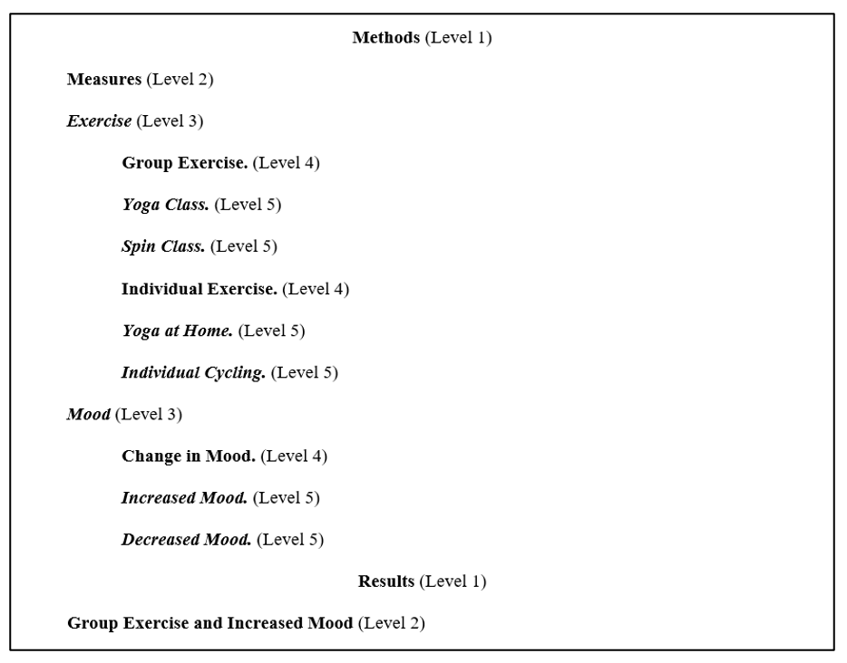
Headings
Here is an example of the five-level heading system:
Notes:
This slide includes a visual example of the five-level heading system.

Slide 37
Tables
Label tables with an Arabic numeral and provide a brief but clear title. The label and title appear on separate lines above the table, flush-left and single-spaced.
Cite a source in a note below the table.
Table 1
Top 3 NBA Season Leaders 2019
Note: This data was collected on December 31st, 2019. Retrieved from https://stats.nba.com/teams/
Team | Points Per Game
Milwaukee Bucks | 119.8
Houston Rockets | 119.1
Dallas Mavericks | 116.8
Notes:
Tables are a common and often required feature of an APA format (consider, the quantitative article, for example). This slide provides visual guidelines to formatting tables in APA.
The facilitator should point that a table format consists of four elements:
The table label—e.g., Table 1
The title in italics, both appearing on separate lines above the table, flush-left and single-spaced
The table
The citation of the source below the table in the form of Note (see the example on the slide).

Slide 38
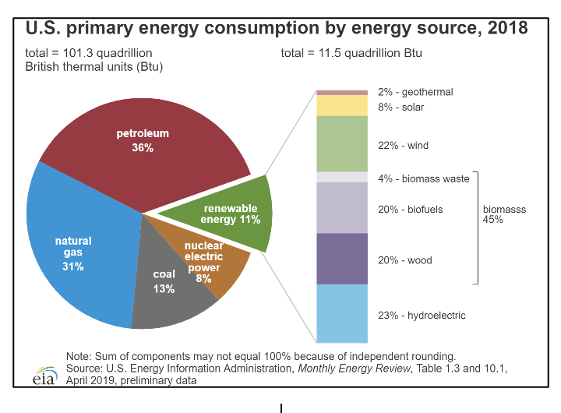
Figures
Label figures with an Arabic numeral and provide a brief but clear title. The label and title appear on separate lines above the figure, flush-left and single-spaced.
  You might provide an additional title centered above the figure.
  Cite the source in a note below the figure.
Figure 1
US Primary Energy Consumption by Energy Source, 2018
Notes:
Although figures in an APA paper are formatted in a manner which is similar to that of formatting tables, there a few differences.
In particular, the order is the following:
You might provide an additional title centered above the figure.
The figure
The label and title (in italics) on the same line below the figure, flush-left: Figure 1. US Primary Energy Consumption by Energy Source, 2018
A citation of the source below the table in the form of Note (see the example on the slide).

Slide 39
Reference
American Psychological Association. (2019). Publication manual of the American Psychological Association (7th ed.). American Psychological Association.
Notes:
Although figures in an APA paper are formatted in a manner which is similar to that of formatting tables, there a few differences.
In particular, the order is the following:
You might provide an additional title centered above the figure.
The figure
The label and title (in italics) on the same line below the figure, flush-left: Figure 1. US Primary Energy Consumption by Energy Source, 2018
A citation of the source below the table in the form of Note (see the example on the slide).

Slide 40
APA Formatting and Style Guide
Brought to you in cooperation with the Purdue Online Writing Lab
Notes:
Writer and Designer: Jennifer Liethen Kunka
Contributors: Muriel Harris, Karen Bishop, Bryan Kopp, Matthew Mooney, David Neyhart, and Andrew Kunka
Revising Author: Ghada M. Gherwash and Joshua M. Paiz, 2014 Elizabeth Angeli, 2011; Elena Lawrick, 2008; Arielle McKee, 2014; Katie McMorris, 2019; Katie McMorris, 2020; Ghada Seif Eddine, 2025
Developed with resources courtesy of the Purdue University Writing Lab
Grant funding courtesy of the Multimedia Instructional Development Center at Purdue University
© Copyright Purdue University, 2000, 2006, 2007, 2008, 2019, 2020, 2025

